Slide 1


Prompting & Error correction
Behavior Technician Curriculum

Slide 2
Objectives
Define prompting and error correction
Identify and use different prompt levels
Implement least-to-most and most-to-least prompting
Use effective error correction procedures
Reduce prompt dependence and promote independence

Slide 3
Prompting procedures
A prompt is a cue or assistance provided to help an individual perform a desired behavior or complete a task.
🗳️ Group question:
“What is a prompt?”
Goal = Independence

Slide 4
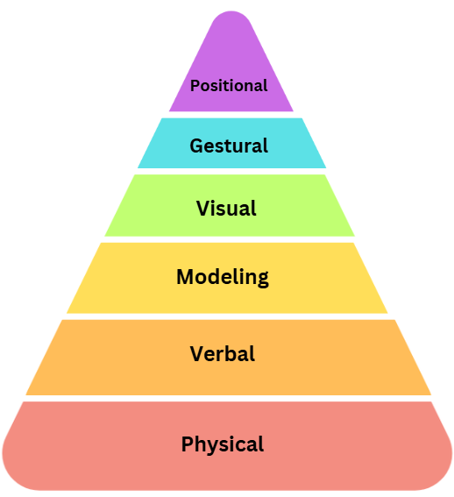
What are the different prompt types?
Adjusting the environment to make the correct response more apparent.
Using pictures or icons to guide the individual.
Using gestures to guide the individual such as pointing.
Demonstrating the desired behaviors for the person to imitate.
Using spoken words to guide and individual toward the correct response or behavior.
Physically guiding or assisting the individual to perform the action.

Slide 5
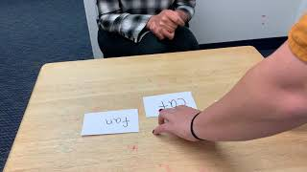
POSITIONAL PROMPTING
DEFINITION
A positional prompt is a technique used to encourage a desired response by strategically placing objects or stimuli closer to the learner.
EXAMPLE
A therapist wants a child to select a specific picture, they might put that picture closer than others to the student to subtly guide their choice.
FADING PROMPTS
Gradually adjust the distance back to its original position.

Slide 6
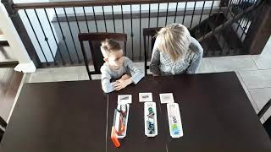
VISUAL PROMPTING
DEFINITION
A visual prompt is a technique that uses images, symbols, or written instructions to guide a learner towards the correct response.
EXAMPLE
A student needs to sit down on the carpet. The RBT shows the student a visual icon of a student sitting down.
FADING PROMPTS
Full Visual Prompts
Simply the visuals
Increase the delay of the prompt
Remove the prompt entirely.

Slide 7
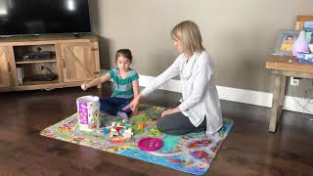
GESTURAL PROMPTING
DEFINITION
A gestural prompt is a type of assistance or cue provided through physical movement or non-verbal signs to guide an individual towards the correct response.
EXAMPLE
Pointing to the chair to indicate where the student should sit.
GESTURE PROMPTS
Pointing
Nodding or Shaking Head
Hand Gestures
Facial Expressions

Slide 8
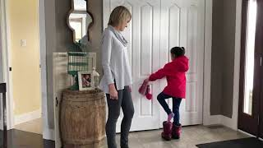
VERBAL PROMPTING
Full verbal & Partial verbal
DEFINITION
A verbal prompt is a type of assistance provided through spoken words to guide and individual toward the correct response or behavior.
EXAMPLE
Saying, “What do you say?” after someone gives a child a lollipop.
FADING PROMPTS
Full Verbal Prompt
Partial Verbal Prompt
Indirect Prompt

Slide 9
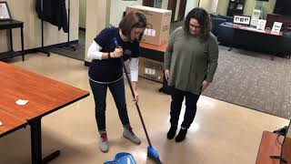
MODELING PROMPTING
DEFINITION
A model prompt involves demonstrating the desired behavior or action for an individual to imitate or replicate.
EXAMPLE
If teaching greetings saying “hello” and wave, prompting the student to imitate.
FADING PROMPTS
Model the full task.
Model part of the task.
Move towards using verbal and gestural cues.

Slide 10
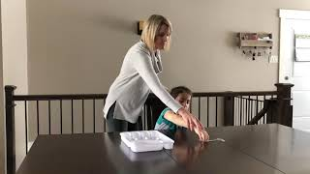
PHYSICAL PROMPTING
Full physical & Partial physical
DEFINITION
A physical prompt involves physically guiding a learner to complete an action.
EXAMPLE
A teacher might use hand over hand assistance to help a student write their name.
FADING PROMPTS
Full Physical Prompt
Partial Physical Prompt

Slide 11

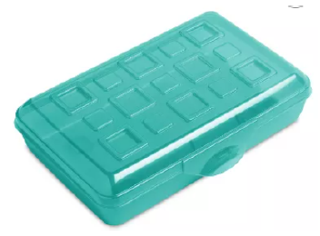
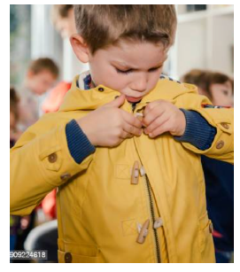
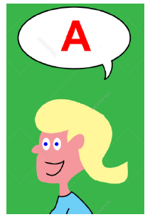
WHAT PROMPT Could YOU USE?
Instruction – “say Apple”
Instruction “get your pencil”
Demand – button your coat

Slide 12

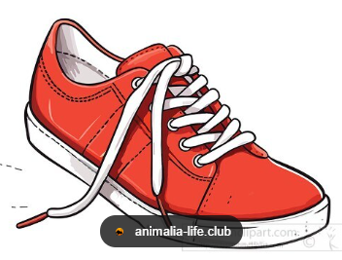

Let’s practice!
Instruction – “find shoe”
What does a Gestural prompt look like?
What about Visual?
Can you think of one more prompt?

Slide 13
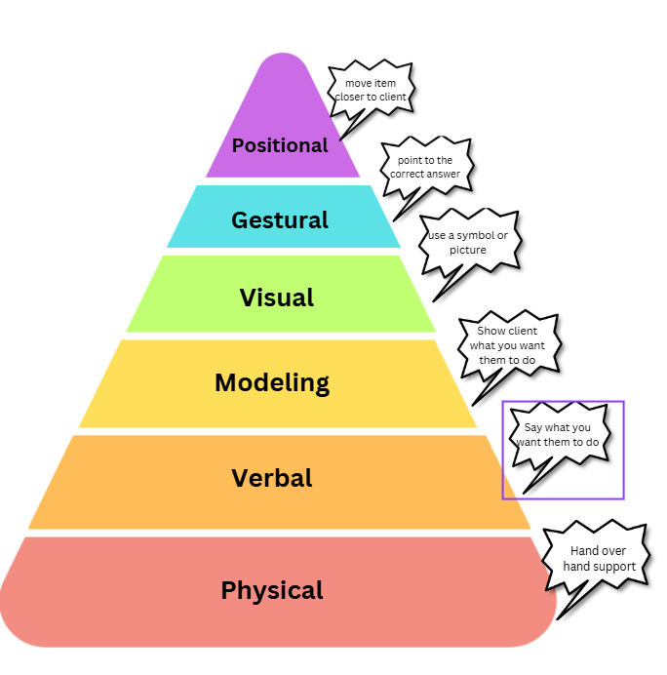
Questions?
Next: How do I choose the prompt?

Slide 14


How do I know which prompt to start with?
When deciding on the prompt to start with, we have 2 different strategies we rely on:
* reminder that the goal is always fading prompts to get to independence*
Least – to – Most
Most – to – Least

Slide 15
Least – to – Most
Start with the LEAST intrusive
This gives the child a chance to perform the skill on their own
This is where we start with most clients!
Start here

Slide 16
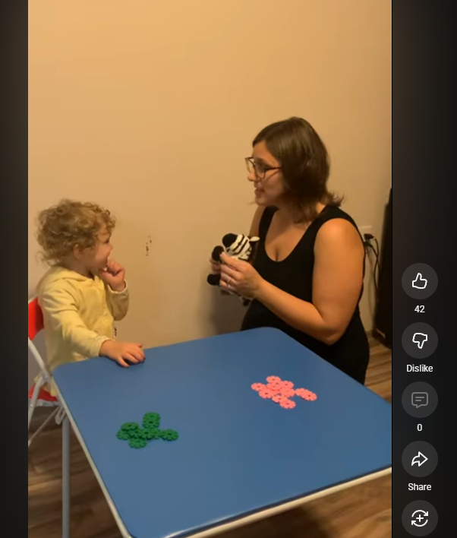
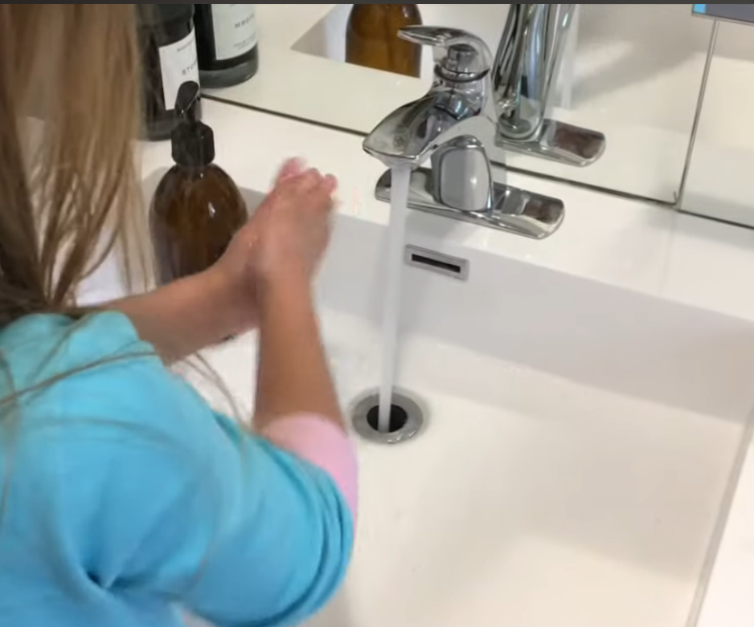
LEAST TO MOST PROMPTING
Verbal - least-to-most
**Reminder**
Start with the LEAST intrusive prompt, and increase prompting only if needed
Hand Washing example
Start at 1:10

Slide 17
Most – to – Least
Start with the MOST intrusive
If client responds appropriately, immediately move to the next prompt down
This is typically used for specific programs, or a specific type of learner!
Start here

Slide 18
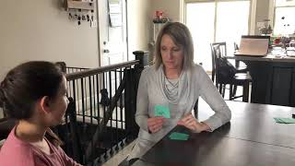
MOST TO LEAST PROMPTING
Most-To-Least Prompting: A strategy that involves starting with the most intrusive prompt and gradually reducing it as the learner becomes more proficient.

Slide 19
Common prompting errors
Prompting too soon
Not fading prompts
Inconsistent prompting
Reinforcing prompted responses equally

Slide 20
Error Correction
Ok, I know the prompts…
How do I use them?
1. Interrupt error
2. Prompt correct response
3. Reinforce (less)
4. Re-present SD

Slide 21




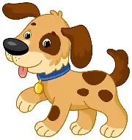

Example
Instruction: Touch dog
Incorrect
Restate instruction “touch dog”
Prompt correct
Reinforce
Re-test for independence

Slide 22
Positional
Modeling
Visual
What do we remember?
Gestural
Physical
Verbal
strategically placing objects or stimuli closer to the learner
uses images, symbols, or written instructions to guide a learner towards the correct response.
cue provided through physical movement or non-verbal signs to guide an individual towards the correct response.
assistance provided through spoken words to guide and individual toward the correct response
demonstrating the desired behavior or action for an individual to imitate or replicate.
physically guiding a learner to complete an action.
Positional
Physical
Verbal
Modeling
Visual
Gestural

Slide 23

Grab a partner & two items
- Run the steps of error correction then switch

Slide 24
Grab a partner & two items
- Give instruction to “find ____”
- Use LTM or MTS prompting

Slide 25

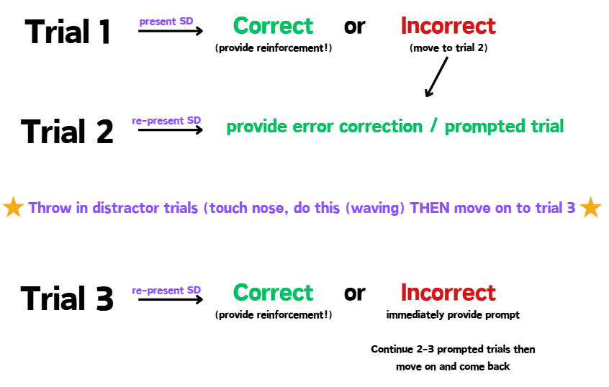
Take a picture!

Slide 26
Take a picture!

Slide 27

Questions?

Slide 28
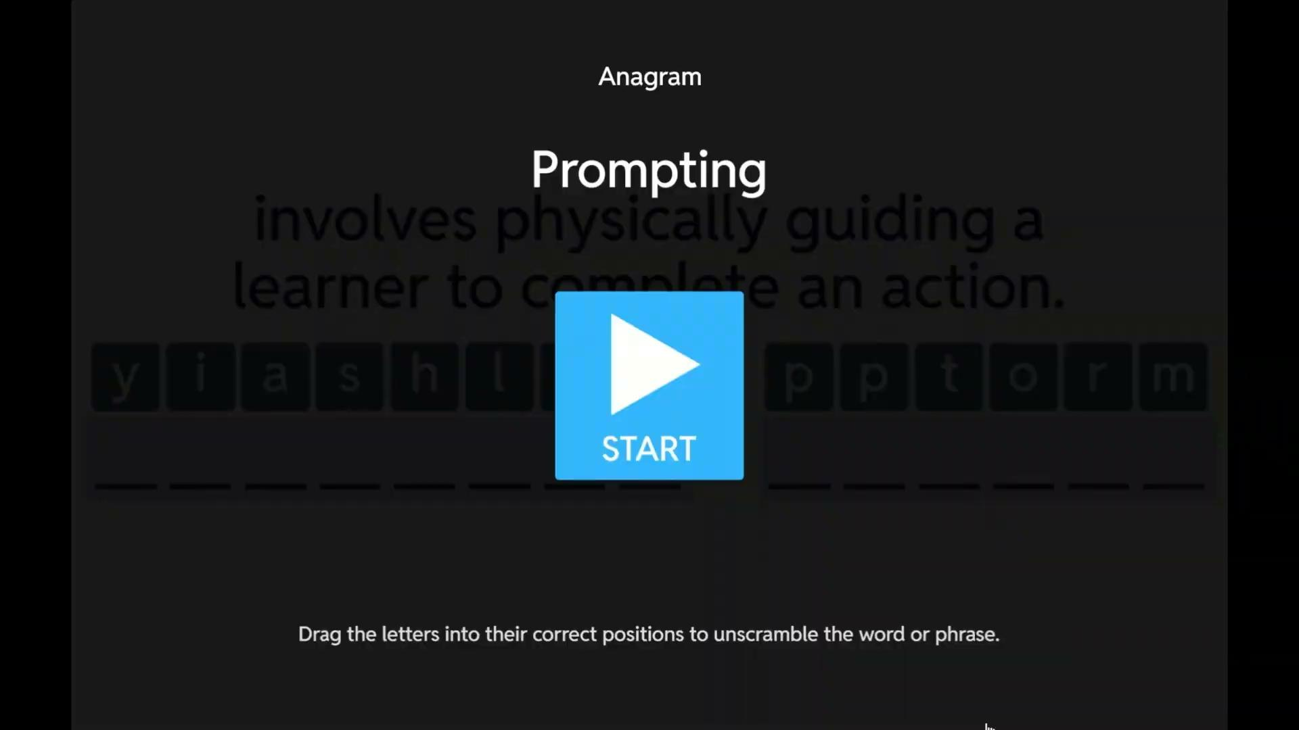
ABA SCRAMBLE

Slide 29
RESOURCES
Autism Clinic. (2016, May 26). DTT - Maintenance. YouTube. https://www.youtube.com/watch?v=Ic6B2qXAbHc
Autism Learning Partnership. (2020, September 9). Visual Prompts. YouTube. https://www.youtube.com/watch?v=WwD72X8AC0E
Autism Learning Partnership. ‌Fading Prompts - Autism Therapy Video. (n.d.). Www.youtube.com. https://www.youtube.com/watch?v=IwaqAkwbd_w
Autism Learning Partnership. ‌Prompt Fading – Most-to-Least. (n.d.). Www.youtube.com. Retrieved March 20, 2023, from https://www.youtube.com/watch?v=dB2MM_TIfSA
Autism Learning Partnership. Gestural Prompting. (n.d.). Www.youtube.com. https://www.youtube.com/watch?v=7iGvYjKCHpI
Autism Learning Partnership. Physical Guidance/Prompting. (n.d.). Www.youtube.com. https://www.youtube.com/watch?v=R76uxGSAwZw
Notes:
Autism Learning Partnership. Verbal Prompts. (n.d.). Www.youtube.com. https://www.youtube.com/watch?v=ka28BqlWWkE
Cooper, J. O., Heron, T. E., & Heward, W. L. (2007). Applied behavior analysis (2nd ed.). Pearson.
Keri Strejlau. (2019, October 9). Proximity Prompting. YouTube. https://www.youtube.com/watch?v=TqCBg0SHZ08
Megan DeBoom. (2019, May 13). Model Prompt. YouTube. https://www.youtube.com/watch?v=5tZe-ZHOeQ4
‌Prompting least to most. (n.d.). Www.youtube.com. Retrieved December 2, 2025, from https://www.youtube.com/shorts/S9zx1d6DhOM
‌Samanthaa Levy. (2021, October 21). RBT Competency Assessment: Shaping. YouTube. https://www.youtube.com/watch?v=cpd9l7m6xF4
Vanderbilt EBIP. (2016, March 3). Graduated Guidance for Fine Motor Tasks. YouTube. https://www.youtube.com/watch?v=ihuJ9hy_a8o
‌Vanderbilt EBIP. (2015, October 14). Progressive Time Delay (PTD) with Picture Cards. YouTube. https://www.youtube.com/watch?v=U7DbT0o7fUE

Slide 30
RESOURCES
Autism Learning Partnership. Verbal Prompts. (n.d.). Www.youtube.com. https://www.youtube.com/watch?v=ka28BqlWWkE
Cooper, J. O., Heron, T. E., & Heward, W. L. (2007). Applied behavior analysis (2nd ed.). Pearson.
Keri Strejlau. (2019, October 9). Proximity Prompting. YouTube. https://www.youtube.com/watch?v=TqCBg0SHZ08
Megan DeBoom. (2019, May 13). Model Prompt. YouTube. https://www.youtube.com/watch?v=5tZe-ZHOeQ4
‌Prompting least to most. (n.d.). Www.youtube.com. Retrieved December 2, 2025, from https://www.youtube.com/shorts/S9zx1d6DhOM

